Slide 1
Unit 9: Health Care
For Live Session Assignment

Slide 2
Analytics in Health Care: Applying Modeling and Inference
You have studied several methods and models in both classifying categorical responses and predicting continuous responses. We learned in this unit that analytics can be leveraged in health care to improve patient outcomes while facilitating substantial financial savings for patients, hospitals and insurance companies.
Please read the following study on how researchers in Australia modeled inpatient data to help predict readmission. The paper is, “Using routine inpatient data to identify patients at risk of hospital readmission” and can is in the Readmission Logistic Regression.pdf file.
Please address the questions on the next slide in your study of this paper and create a slide for each question to be addressed in live session. Best results will be obtained by reading the paper before addressing the questions. In addition, keep in mind that this is an example of a formal right up similar to what you will do with your Capstone project!
Expectation: I know you are working on your projects this week. It is estimated that the student will spend between 3 and 6 hours on this material to prep for live session. If you hit the 6 hour mark and are not finished, it is ok. As long as the student has read the complete paper at least once and read and started the questions, they will be prepared to contribute an understand others contributions in live session.

Slide 3
Questions to Address With Respect to the Paper
What was the goal / point of the study. In the asynch material we learned that readmissions were expensive. What evidence was presented that quantifies the frequency and expense of readmissions.
What were the characteristics data for this study (size, source, etc.)? Were there any ethical considerations?
What was the response variable specifically and what model was used to model this response?
What software was employed in this study? Could a different software / language have been used? What would you have preferred? If you would have preferred SAS, what procedure would you have used? If R, what package / function would you have used? If Ptyhon, what library and function would you have used? Feel free to describe the tools you would have used different software / languages as well.
What variable selection method(s) was/were used? What were the specifics?
What were the details of the cross validation technique used? Was there a reason why specific values were chosen?
Sensitivity and Specificity were among the statistics used to evaluate this model / algorithm. What did sensitivity and specificity mean in the context of this study? Also, to calculate the sensitivity and specificity we need a ”cut-off” or ”threshold” value. What values were used in this study and what were the corresponding sensitivities and specificities?
Table 4 has the odds ratios associated with the significant variables in the model. Pick two of these and interpret them with their corresponding pvalues and confidence intervals. Write your interpretation as if you are talking with a hospital VP who you assume has weak statistical / data science chops.
Cost Analysis: Review again the Cost and Conclusion sections at the end of the paper. Which is more costly, a false negative or a false positive? (assume “positive” means classifying a patient to readmit and thus receive an intervention.)
BONUS: The VP of this hospital would like to know if it will be useful to employ this model and if so, what he estimated cost savings / advantages are estimated to be. As a starting point, she has asked you to to assume that the cost of an intervention is $500 and the cost of readmission to the hospital is $30,000. She also asked you to assume that 20% of patients will readmit at least once in the following year (we just don’t know which ones) and that there will be 20,000 patients next year. Given this information and the performance of the model given in this paper, create a one or two slide presentation to the VP.

Slide 4
Questions to Address With Respect to the Paper
What was the goal / point of the study. In the asynch material we learned that readmissions were expensive. What evidence was presented that quantifies the frequency and expense of readmissions.
“Containing the cost of acute hospital services has been a feature of health systems around the world since at least the 1980s.”
“For example, a study in Western Australia reported that the top 5% of hospital users accounted for 38% of inpatient costs and 26% of inpatient separations. This top 5% mainly comprised patients with chronic medical conditions.”

Slide 5
Questions to Address With Respect to the Paper
2. What were the characteristics of the data for this study (size, source, etc.)? Were there any ethical considerations?
“Data for public-sector patients were obtained from the Queensland Hospital Admitted Patients Data Collection (QHAPDC), which contains, inter alia, the demographic characteristics of the patients, the principal diagnosis, other conditions treated, and the procedures performed.”
“We used a list of 28 reference conditions (e.g., congestive heart failure, chronic obstructive pulmonary disease, diabetes, dementia)”
“Patients were selected for inclusion in the study if they had an emergency inpatient admission for a reference condition during the financial year 2005/2006.”
“Queensland Health, the data custodian, advised that research ethics approval was not required for this study because the analyses did not use any data that could identify (or potentially identify) an individual patient and because all analyses were completed on Queensland Health premises by a Queensland Health employee (SH). The analyses were done in a secure computing environment in a physically locked area. Access to the computer system is password protected, is subject to monitoring through audit trails and is only accessible to authorized staff.”

Slide 6
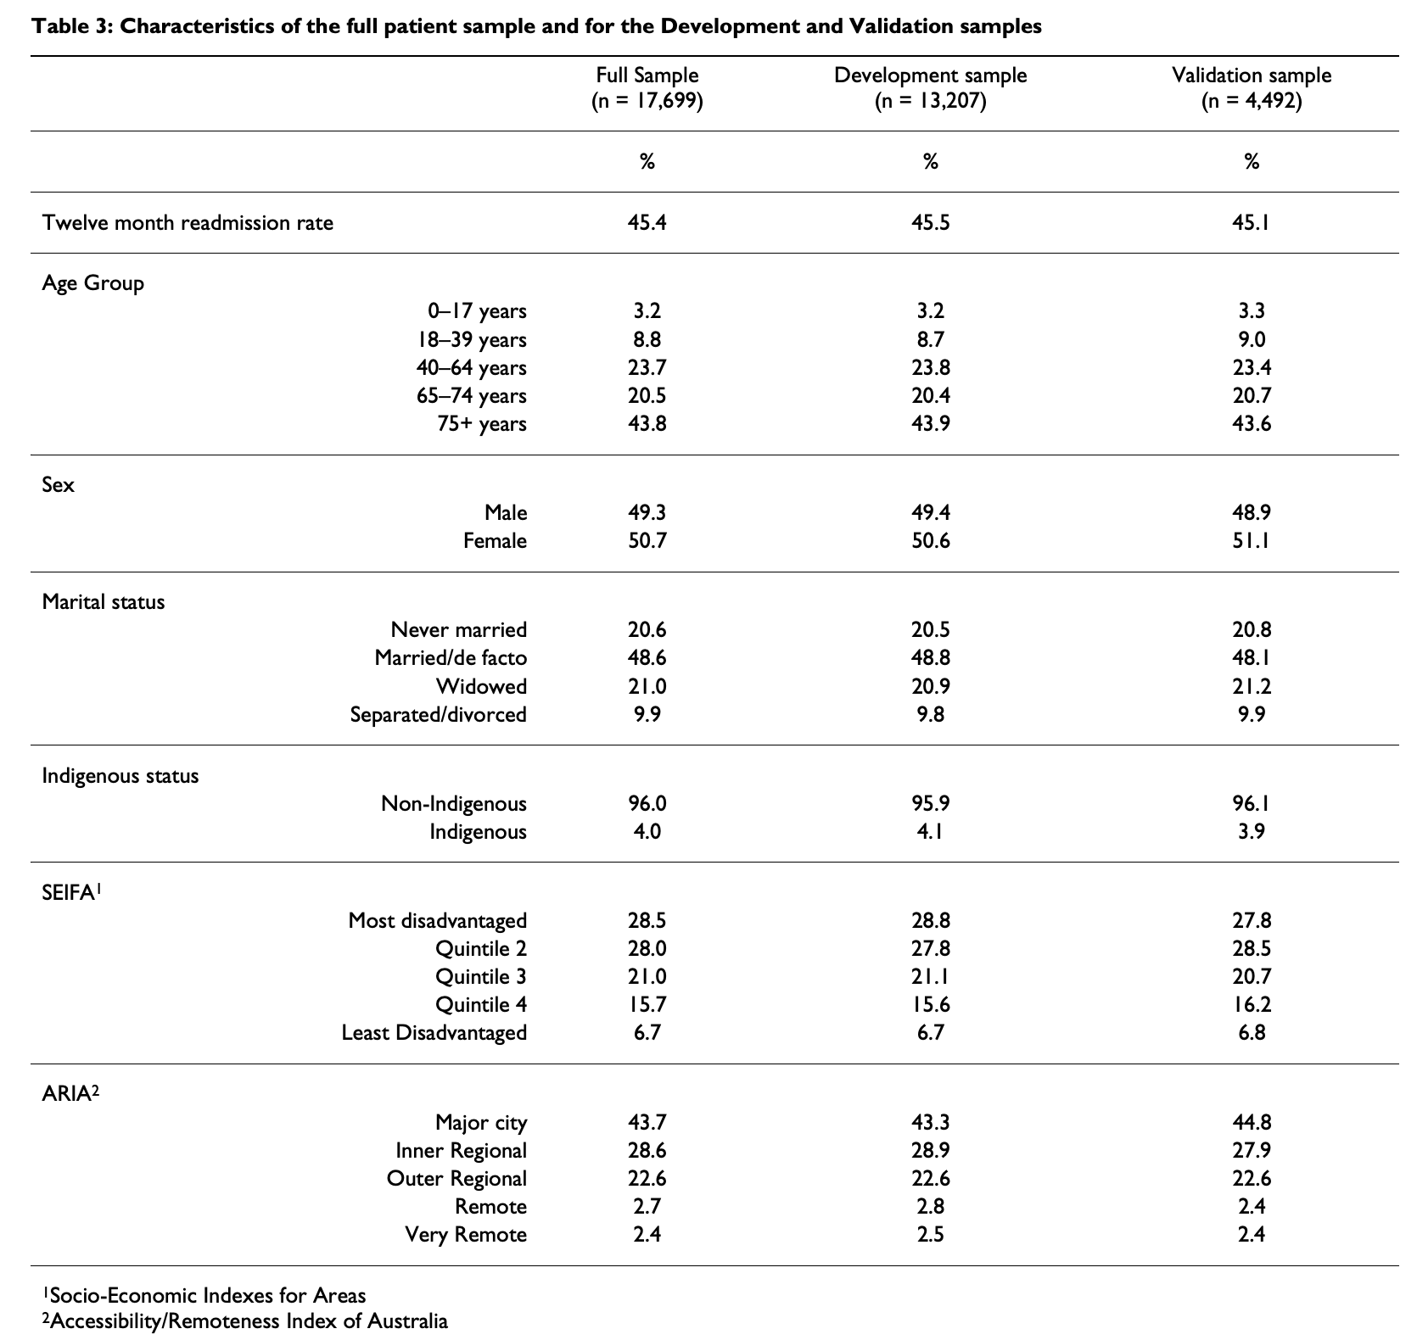
Questions to Address With Respect to the Paper
2. What were the characteristics of the data for this study (size, source, etc.)? Were there any ethical considerations?

Slide 7
Questions to Address With Respect to the Paper
3. What was the response variable specifically and what model was used to model this response?
“We classified a patient as being readmitted if, within the 12 months following discharge for the triggering admission, they had at least one acute admission.”
“The predictive algorithm was developed using logistic regression as implemented by SAS Version 9.1.”
“… the socio-demographic variables were entered into a regression model as a group and the best subset of them was identified using the purposeful selection methods proposed by Hosmer and Lemeshow.”

Slide 8
Questions to Address With Respect to the Paper
4. What software was employed in this study? Could a different software / language have been used? What would you have preferred? If you would have preferred SAS, what procedure would you have used? If R, what package / function would you have used? If Python, what library and function would you have used? Feel free to describe the tools you would have used different software / languages as well.
SAS Version 9.1 (current version 9.4) … proc logistic
https://support.sas.com/rnd/app/stat/papers/logistic.pdf
R … function glm(…,family = "binomial") {package stats}
https://stats.idre.ucla.edu/r/dae/logit-regression/
Python … library(sklearn) function LogisticRegression()
from sklearn.linear_model import LogisticRegression
https://towardsdatascience.com/building-a-logistic-regression-in-python-step-by-step-becd4d56c9c8

Slide 9
Questions to Address With Respect to the Paper
5. What variable selection method(s) was/were used? What were the specifics?
“For example, the socio-demographic variables were entered into a regression model as a group and the best subset [remember Mallow’s Cp statistic from Stat I!] of them was identified using the purposeful selection methods proposed by Hosmer and Lemeshow. The best subsets of co-morbidities and of utilization measures were identified in a similar way. These subsets were then combined and further backward elimination was applied to identify the most parsimonious model. The Likelihood Ratio was assessed to evaluate successive models. Variables were considered as candidates for the model if they were univariately significant at alpha < 0.25. We retained variables that remained significant at alpha < 0.10, as well as those that were identified as confounders. Significant categorical and nominal variables were retained in complete form – that is, all levels of the variable were retained in the model.”

Slide 10
Questions to Address With Respect to the Paper
6. What were the details of the cross validation technique used? Was there a reason why specific values were chosen?
“The predictive algorithm was developed using a 75% training sample selected at random of triggering admissions and validated on the remaining 25%. This cut point was chosen in recognition of the small sample relative to those in other studies, and the large number of candidate variables being evaluated in developing the algorithm. Results from the sensitivity and specificity analysis were similar in the two samples [little evidence of overfitting] (i.e. varied by < 3%), and findings from the validation sample are reported here.”

Slide 11
Questions to Address With Respect to the Paper
7. Sensitivity and Specificity were among the statistics used to evaluate this model / algorithm. What did sensitivity and specificity mean in the context of this study? Also, to calculate the sensitivity and specificity we need a ”cut-off” or ”threshold” value. What values were used in this study and what were the corresponding sensitivities and specificities?
sensitivity - percentage of patients readmitted in the next 12 months who were correctly identified by the algorithm
specificity - percentage of patients not readmitted in the next 12 months who were not flagged by the algorithm
“Sensitivity, specificity and the false positive rate were estimated by comparing the actual readmissions with readmissions as predicted by the algorithm; these were evaluated using three separate cut-points of predicted risk from the algorithm (i.e., the logistic regression model): 50%, 70% and 80%.”

Slide 12
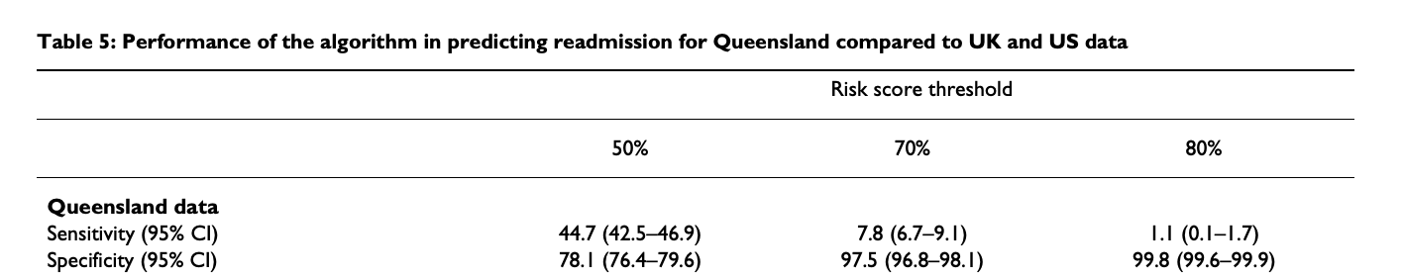
Questions to Address With Respect to the Paper
7. Sensitivity and Specificity were among the statistics used to evaluate this model / algorithm. What did sensitivity and specificity mean in the context of this study? Also, to calculate the sensitivity and specificity we need a ”cut-off” or ”threshold” value. What values were used in this study and what were the corresponding sensitivities and specificities?

Slide 13
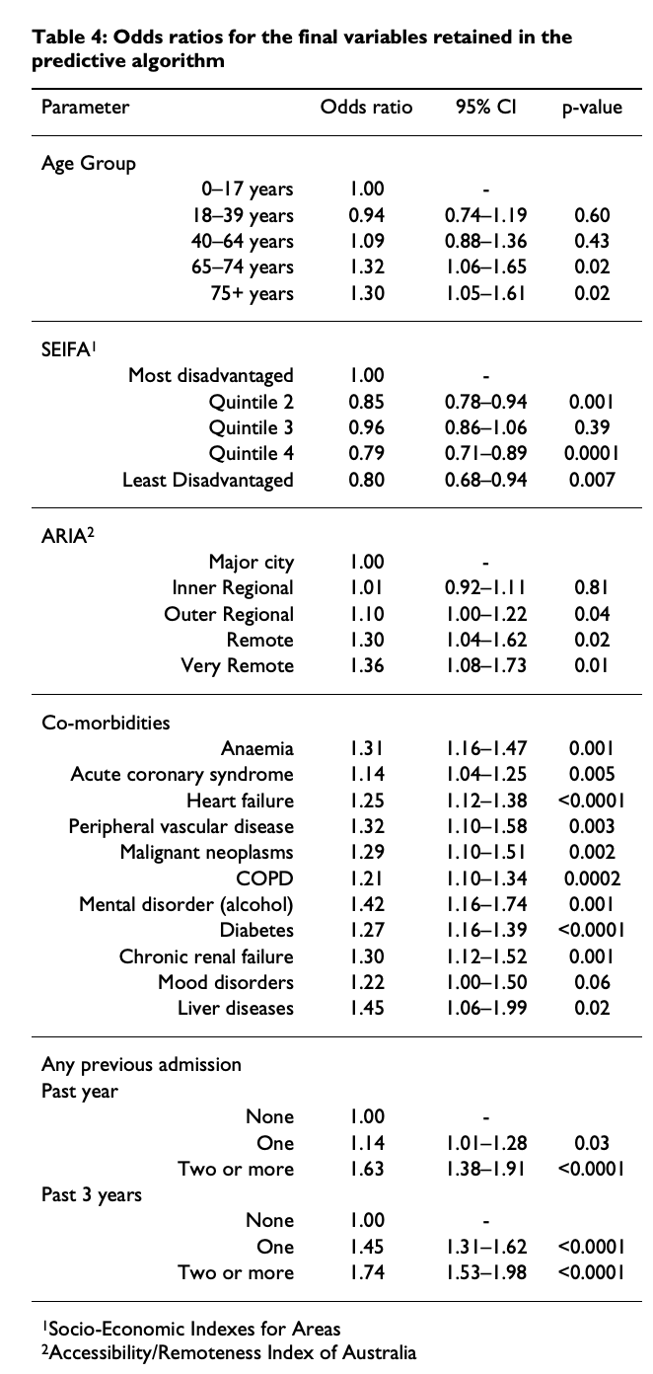
Questions to Address With Respect to the Paper
8. Table 4 has the odds ratios associated with the significant variables in the model. Pick two of these and interpret them with their corresponding pvalues and confidence intervals. Write your interpretation as if you are talking with a hospital VP who you assume has weak statistical / data science chops.
There is sufficient evidence to suggest that, holding all other variables constant, the odds of readmission for 65-74 year olds is greater than that of those who are 17 years old or younger (pvalue = .02). We are 95% confident that the odds of readmission for 65-74 year olds is between 1.06 and 1.65 times that of those who are 17 years old or less. Our study suggests the best estimate is 1.32 times (a 32% increase).
There is overwhelming evidence to suggest that, holding all other variables constant, the odds of readmission for those with heart failure are greater than those without heart failure (pavlue < .0001). We are 95% confident that this those with heart failure have odds of readmission between 1.12 and 1.38 times that of those who do not have heart failure. Our study suggests the best estimate is 1.25 times (a 25% increase).

Slide 14
Questions to Address With Respect to the Paper
9. Cost Analysis: Review again the Cost and Conclusion sections at the end of the paper. Which is more costly, a false negative or a false positive? (assume “positive” means classifying a patient to readmit and thus receive an intervention.)
False Negative: This would be not flagging someone to readmit when they actually did readmit.
False Positive: This would be flagging someone to readmit when they actually did not readmit.
For a single patient the false negative is much more costly. Readmissions can cost tens if not hundreds of thousands of dollars. The thought is that we can give a much less costly intervention that will both save the patient and the insurance company money while increasing the health outcome / quality of life for the patient. A false negative will result in a missed opportunity to deliver this intervention and thus the incursion of the high expense.
A false positive still has a cost to it; however, for one patient, it is much less. If our model identifies some one who would readmit when they actually would not have readmitted, then we will incur the intervention cost when we did not have to pay it.
It is not realistic to expect of have a model with 100% sensitivity and specificity, therefore we can perform a cost analysis given the estimated sensitivity and specificity of competing models. (Next!)

Slide 15
Questions to Address With Respect to the Paper
10. BONUS: The VP of this hospital would like to know if it will be useful to employ this model and if so, what the cost savings / advantages are estimated to be. As a starting point, she has asked you to to assume that the cost of an intervention is $500 and the cost of readmission to the hospital is $30,000. She also asked you to assume that 20% of patients will readmit at least once in the following year (we just don’t know which ones) and that there will be 20,000 patients next year. Given this information and the performance of the model given in this paper, create a one or two slide presentation to the VP.

Slide 16
Advantages of the Readmission Model!
Cost Savings in $$$
20,000 patients
20% readmitted (4,000 patients will actually readmit)
$500 per intervention
$30,000 for each readmission
If we do nothing, the cost will be 4000*$30,000 = $120,000,000
Our model identifies 44.7% of the 4,000 patients that will readmit (1,788).
Our model falsely predicts a readmit for 21.9% of the 16,000 patients that will not readmit (3,504).
Our model misses 55.3% of the 4,000 that will readmit (2,212).
If we give each of these a $500 intervention then this will cost: 1788*$500 = $894,000
If we give each of these a $500 intervention then this will cost: 3504*$500 =$1,752,000
This will cost: 2212 * $30,000 = $66,360,000
Savings: Cost without Intervention Program – Cost with Intervention Program
Savings: $120,000,000 – ($894,000 + $1,752,000 + 66,360,000) = $50,994,000

Slide 17
Advantages of the Readmission Model!
Improved Health and Quality of Life
20,000 patients
20% readmitted (4,000 patients will actually readmit)
$500 per intervention
$30,000 for each readmission
If we do nothing 4000 patients will be readmitted to the hospital.
4000 will suffer degenerated Health: Infection, Stroke, Broken Bones, Etc
4000 will suffer time away from family and friends
Our model identifies 41% of the 4,000 patients that will readmit:
1,640 patients will avoid these hardships!
While saving over $50,000,000!!!

Slide 18
Additional Question!
There was a lot of room for improvement in this model. What if you could increase the sensitivity and specificity by just 1 point? How much more would you save?
Back to the original model (with sensitivity = .49 and specificity = .63) Would it be better at $500 to simply give everyone the intervention?
What if the intervention costs $6000? What are the savings of using the model? Of simply giving the intervention to everyone? Is there an advantage to using the model?
Given the model performance, how much would the intervention have to cost to eliminate the savings from using the model?

